Slide 1
Programming Fundamentals
By
Shazmeen Batool

Slide 2
Previous Lecture
Abstract Data Type
Structures
Accessing Elements of Structures

Slide 3
Today’s Lecture
Accessing Elements of Structures
Comparing Structures Variables
Initializing Structure Variable

Slide 4
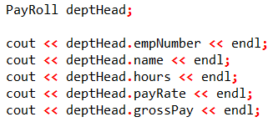
Accessing the Elements of Structure
With the dot operator you can use member variables just like regular variables.
For example these statements display the contents of deptHead ’s members:

Slide 5
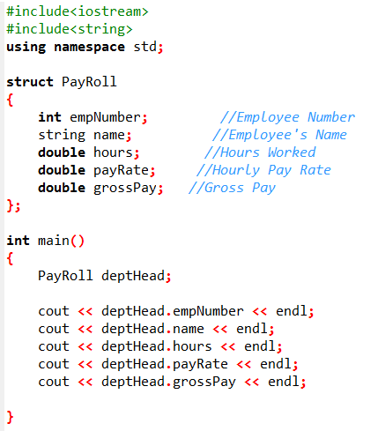

Slide 6
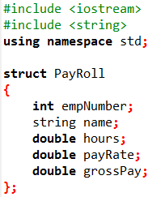
Example 1/3

Slide 7
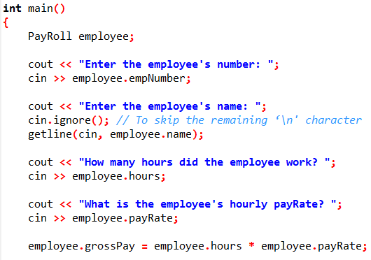
Example 2/3

Slide 8
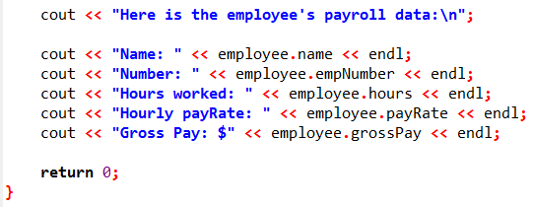
Example 3/3

Slide 9
Accessing the Elements of Structure
cin.ignore();
Recall that the ignore function causes cin to ignore the next character in the input buffer. This is necessary for the getline function to work properly in the program.

Slide 10
Accessing the Elements of Structure
The contents of a structure variable cannot be displayed by passing the entire variable to cout. For example, assuming employee is a PayRoll structure variable, the following statement will not work:
Instead, each member must be separately passed to cout.

Slide 11
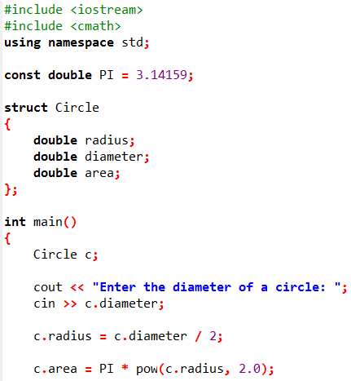
Example 1/2

Slide 12
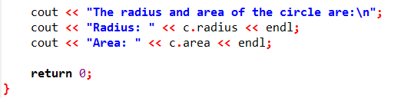

Example 2/2

Slide 13
Comparing Structure Variables
You cannot perform comparison operations directly on structure variables. For example, assume that circle1 and circle2 are Circle structure variables.
The following statement will cause an error.
if (circle1 == circle2) // Error!

Slide 14
Comparing Structure Variables
In order to compare two structures, you must compare the individual members, as shown in the following code.
if (circle1.radius == circle2.radius && circle1.diameter == circle2.diameter && circle1.area == circle2.area)

Slide 15
Initializing Structure Variable
The members of a structure variable may be initialized with starting values when the structure variable is defined.
A structure variable may be initialized when it is defined, in a fashion similar to the initialization of an array.

Slide 16
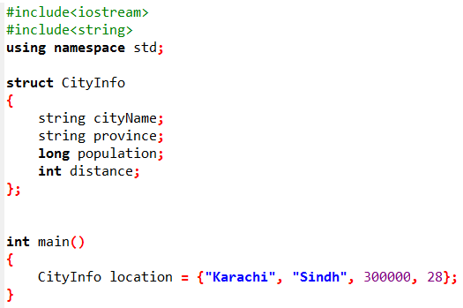

Slide 17
Initializing Structure Variable
You do not have to provide initializers for all the members of a structure variable. For example, the following statement only initializes the cityName member of location :
CityInfo location = {“Lahore"};
The state , population , and distance members are left uninitialized.
The following statement only initializes the cityName and state members, while leaving population and distance uninitialized:
CityInfo location = {“Lahore", “Punjab"};

Slide 18
Initializing Structure Variable
If you leave a structure member uninitialized, you must leave all the members that follow it uninitialized as well. C++ does not provide a way to skip members in a structure.
For example, the following statement, which attempts to skip the initialization of the population member, is not legal:
CityInfo location = {“Karachi", “Sindh", , 90}; // Illegal!

Slide 19
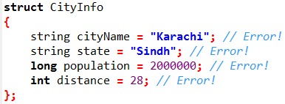
Initializing Structure Variable
It’s important to note that you cannot initialize a structure member in the declaration of the structure.
For instance, the following declaration is illegal:

Slide 20
Initializing Structure Variable
Remember that a structure declaration doesn’t actually create the member variables. It only declares what the structure “looks like.”
The member variables are created in memory when a structure variable is defined. Because no variables are created by the structure declaration, there’s nothing that can be initialized there.

Slide 21
Activity
Write a structure declaration to hold the following data about a savings account:
Account Number ( string object)
Account Balance ( double )
Interest Rate ( double )
Average Monthly Balance ( double )

Slide 22
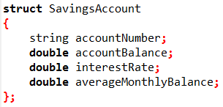
Activity

Slide 23
Activity
Write a definition statement for a variable of the structure you declared in previous question. Initialize the members with the following data:
Account Number: ACZ42137-B12-7
Account Balance: $4512.59
Interest Rate: 4%
Average Monthly Balance: $4217.07

Slide 24
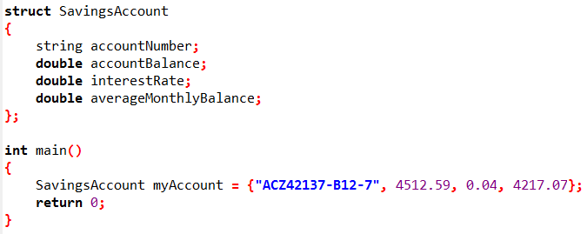
Activity

Slide 25
Next Lecture
Array as a Member of Structure
Array of Structures
Nested Structures
Structures and Functions
Structures and Pointers

